Slide 1
The Fast Fourier Transform
Presentation for use with the textbook, Algorithm Design and Applications, by M. T. Goodrich and R. Tamassia, Wiley, 2015

Slide 2
Polynomials
Polynomial:
In general,

Slide 3
Polynomial Evaluation
Horner’s Rule:
Given coefficients (a₀,a₁,a₂,…,a_{n-1}), defining polynomial
Given x, we can evaluate p(x) in O(n) time using the equation
Eval(A,x): [Where A=(a₀,a₁,a₂,…,a_{n-1})]
If n=1, then return a₀
Else,
Let A’=(a₁,a₂,…,a_{n-1}) [assume this can be done in constant time]
return a₀+x*Eval(A’,x)

Slide 4
Polynomial Multiplication Problem
Given coefficients (a₀,a₁,a₂,…,a_{n-1}) and (b₀,b₁,b₂,…,b_{n-1}) defining two polynomials, p() and q(), and number x, compute p(x)q(x).
Horner’s rule doesn’t help, since
where
A straightforward evaluation would take O(n²) time. The “magical” FFT will do it in O(n log n) time.

Slide 5
Polynomial Interpolation & Polynomial Multiplication
Given a set of n points in the plane with distinct x-coordinates, there is exactly one (n-1)-degree polynomial going through all these points.
Alternate approach to computing p(x)q(x):
Calculate p() on 2n x-values, x₀,x₁,…,x_{2n-1}.
Calculate q() on the same 2n x values.
Find the (2n-1)-degree polynomial that goes through the points {(x₀,p(x₀)q(x₀)), (x₁,p(x₁)q(x₁)), …, (x_{2n-1},p(x_{2n-1})q(x_{2n-1}))}.
Unfortunately, a straightforward evaluation would still take O(n²) time, as we would need to apply an O(n)-time Horner’s Rule evaluation to 2n different points.
The “magical” FFT will do it in O(n log n) time, by picking 2n points that are easy to evaluate…

Slide 6
Primitive Roots of Unity
A number ω is a primitive n-th root of unity, for n>1, if
ω^{n} = 1
The numbers 1, ω, ω², …, ω^{n-1} are all distinct
Example 1:
Z*₁₁:
2, 6, 7, 8 are 10-th roots of unity in Z*₁₁
2²=4, 6²=3, 7²=5, 8²=9 are 5-th roots of unity in Z*₁₁
2⁻¹=6, 3⁻¹=4, 4⁻¹=3, 5⁻¹=9, 6⁻¹=2, 7⁻¹=8, 8⁻¹=7, 9⁻¹=5
Example 2: The complex number e^{2πi/n} is a primitive n-th root of unity, where

Slide 7
Properties of Primitive Roots of Unity
Inverse Property: If ω is a primitive root of unity, then ω ⁻¹=ω^{n-1}
Proof: ωω^{n-1}=ω^{n}=1
Cancellation Property: For non-zero -n<k<n,
Proof:
Reduction Property: If w is a primitve (2n)-th root of unity, then ω² is a primitive n-th root of unity.
Proof: If 1,ω,ω²,…,ω^{2n-1} are all distinct, so are 1,ω²,(ω²)²,…,(ω²)^{n-1}
Reflective Property: If n is even, then ω^{n/2} = -1.
Proof: By the cancellation property, for k=n/2:
Corollary: ω^{k+n/2}= -ω^{k}.

Slide 8
The Discrete Fourier Transform
Given coefficients (a₀,a₁,a₂,…,a_{n-1}) for an (n-1)-degree polynomial p(x)
The Discrete Fourier Transform is to evaluate p at the values
1,ω,ω²,…,ω^{n-1}
We produce (y₀,y₁,y₂,…,y_{n-1}), where y_{j}=p(ω^{j})
That is,
Matrix form: y=Fa, where F[i,j]=ω^{ij}.
The Inverse Discrete Fourier Transform recovers the coefficients of an (n-1)-degree polynomial given its values at 1,ω,ω²,…,ω^{n-1}
Matrix form: a=F ⁻¹y, where F ⁻¹[i,j]=ω^{-ij}/n.

Slide 9
Correctness of the inverse DFT
The DFT and inverse DFT really are inverse operations
Proof: Let A=F ⁻¹F. We want to show that A=I, where
If i=j, then
If i and j are different, then

Slide 10
Convolution
The DFT and the inverse DFT can be used to multiply two polynomials
So we can get the coefficients of the product polynomial quickly if we can compute the DFT (and its inverse) quickly…

Slide 11

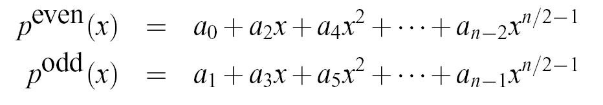

The Fast Fourier Transform
The FFT is an efficient algorithm for computing the DFT
The FFT is based on the divide-and-conquer paradigm:
If n is even, we can divide a polynomial
into two polynomials
and we can write

Slide 12
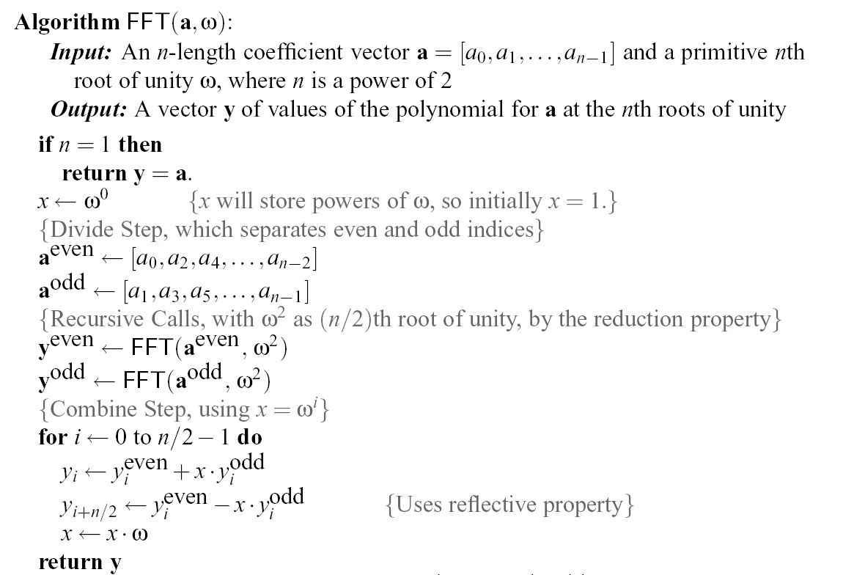
The FFT Algorithm
The running time is O(n log n). [inverse FFT is similar]

Slide 13
Multiplying Big Integers
Given N-bit integers I and J, compute IJ.
Assume: we can multiply words of O(log N) bits in constant time.
Setup: Find a prime p=cn+1 that can be represented in one word, and set m=(log p)/3, so that we can view I and J as n-length vectors of m-bit words.
Finding a primitive root of unity.
Find a generator x of Z*_{p}.
Then ω=x^{c} is a primitive n-th root of unity in Z*_{p} (arithmetic is mod p)
Apply convolution and FFT algorithm to compute the convolution C of the vector representations of I and J.
Then compute
K is a vector representing IJ, and takes O(n log n) time to compute.

Slide 14
Non-recursive FFT
There is also a non-recursive version of the FFT
Performs the FFT in place
Precomputes all roots of unity
Performs a cumulative collection of shuffles on A and on B prior to the FFT, which amounts to assigning the value at index i to the index bit-reverse(i).
The code is a bit more complex, but the running time is faster by a constant, due to improved overhead

